Slide 1
Sabbatical Overview
FA Contract Article V Faculty Benefits
Section D Paid Leave Provision 4 Sabbaticals
Sabbatical leaves are awards made by the President to those eligible members of the faculty who propose projects relevant to their primary discipline, which will enhance their professional competence and will enrich their teaching and/or service to the institution upon their return to the College. Sabbatical leaves may be granted for one or more of the following: a comprehensive graduate program; writing a significant work for publication; doing a significant research project or dissertation that complies with the permitted purposes for a sabbatical and is within the context of professional review; developing a new curriculum or program which is consistent with College plans; or other significant academic or intellectual projects.

Slide 2
Sabbatical Overview
FA Contract Article V Faculty Benefits
Section D Paid Leave Provision 4 Sabbaticals
Eligible after 6 years of full-time service since joining the faculty (for a first sabbatical) or since returning from a previous sabbatical (for a second or later sabbatical). If your last sabbatical was 7 years ago, you're eligible.
One semester at full pay or one year at half pay. Twelve-month counselors see provision 4.c.3. Some limitations if there’s undue impact on a department or area (but not if you’re a one-person department); see provision 4.c.4.
Released from your full-time work duties; you may still serve on committees or advise a student club, etc., if you wish.
Contractual timeline (provision 4.d.1): College brief goes out by September 15, applications due by October 15, committee typically meets by end of December, and committee recommendations are acted upon by the president by January 15.

Slide 3
Sabbatical Overview
FA Contract Article V Faculty Benefits
Section D Paid Leave Provision 4 Sabbaticals
Application requirements (provision 4.d.2-3):
Applications shall include the submission of a statement of purpose that demonstrates individual professional growth or a benefit to a College program. Individual professional growth shall be defined as pursuit of knowledge related to the faculty member's discipline or duties at the College, to the teaching profession, or to an approved retraining program. The Sabbatical Committee, by majority vote, may also require additional information from the applicant.
In addition to existing criteria, the applicant must demonstrate that the sabbatical proposal will involve activity at least equivalent to a full-time teaching/workload and is beyond the professional activity expected to be performed concurrent with full-time duties.

Slide 4
Sabbatical Overview
FA Contract Article V Faculty Benefits
Section D Paid Leave Provision 4 Sabbaticals
Faculty obligations (provision 4.e.1-3):
Faculty must complete the sabbatical as awarded or as modified with committee approval. Failure to complete the sabbatical will result in the faculty member having to repay the college their one semester of pay or their full year of half pay. Faculty must continue in their full-time position for a minimum of one year following the completion of the sabbatical.
Also: Faculty must provide a written report within 8 weeks of return from sabbatical documenting the completion of the work in the approved application. E.g., if you write a dissertation or book, you must submit the dissertation or book (not just a summary of those). To approve your report, the committee needs to see your final product in some fashion.

Slide 5
Sabbatical Overview
FA Contract Article V Faculty Benefits
Section D Paid Leave Provision 4 Sabbaticals
Committee (provision 4.f.1-4):
Consists of 4 FA members appointed by FA president and 4 administrators appointed by college president. Co-chairs are FA Secretary and VPAA who are non-voting members.
Committee reviews blind applications and bases decisions on merit by majority vote.
Committee may approve up to 9 full-year and 9 semester sabbaticals each year (provision 4.a.1), but not if there aren’t enough to meet the merit criteria. Committee makes recommendation to college president who ultimately decides which applications will be awarded sabbaticals.

Slide 6
Sabbatical Overview
Info & Advice
Submit your application to to Michele Glavich (glavicm@sunysuffolk.edu) in VPAA office with a cc: to me (cynthia@fascc.org)
I can and will provide feedback and advice on your drafts prior to the October 15 due date, but I cannot tell you what will ensure that your application will be approved by the committee. I do not live inside the minds of the six voting committee members. However, I can provide advice based on what I know from my years of experience as co-chair of the committee. Just keep in mind that I am not the person you have to convince. I share some advice here, but my overall advice is to remember that you are presenting an argument that your application should be approved, and arguments are best supported with specific, solid reasoning and documentation.

Slide 7
Sabbatical Overview
Info & Advice
Provide contact info, previous sabbaticals or leaves of absence, and list preferences: spring, fall, or full year. Do not list a full year if you don’t want it (if awarded a full year, you must take a full year at half pay).
Info & Advice
Top three reasons why applications are unsuccessful:
Proposed project is not directly related to your work duties or is inappropriate in amount of work (it fails to go above & beyond job description; it’s not more than 35 hours/week of work; less often it might be too ambitious) Most proposals that fail are because they don’t rise to the level of a full semester of work. Be clear and as detailed as possible about the work involved. E.g., make plain this could not be done with a light load semester.

Slide 8
Sabbatical Overview
Info & Advice
Top three reasons why applications are unsuccessful:
The timeline is missing or problematic, doesn’t show sufficient preparatory work, actual sabbatical-semester work (weekly, biweekly, or at least month), and/or any follow up. Committee looks for clarity and attention to detail. Include summer or winter work before and after sabbatical too.
The project benefit to applicant (focus on your development) and/or to college (focus on others) is insufficiently convincing. If anything, over-emphasize specific benefits to the college. Committee wants to see measurable outcomes. Connect to the current strategic plan (next slide). What “product” are you bringing back? What would you share with colleagues and how? How will your work benefits colleagues and/or especially students?

Slide 9
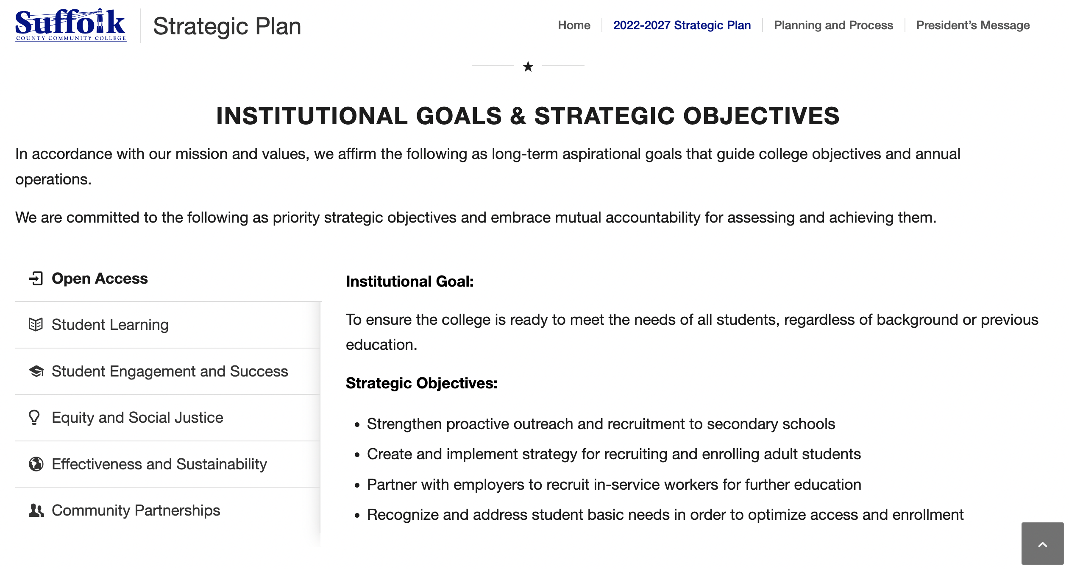
sunysuffolk.edu/about-suffolk/office-of-planning-and-institutional-effectiveness/strategic-plan/2022-2027

